Slide 1
Data 618: Brain Stumper4
Ramnivas Singh
MSDS CUNY - 2022

Slide 2
Summary :
Source monthly oil and motor fuel price data for a significant period (~ 30 years or longer) from a reputable source (E.g.: US Energy Information Administration - https://www.eia.gov/)
Source inflation rate (CPI and PPI) data from an authoritative source (E.g.: US Bureau of Labor Statistics - https://www.bls.gov/)
Determine and plot the correlation between energy costs and inflation and demonstrate its change over the period studied.
Provide an assessment of the causes for the changes.
Commit your analyses, code used, results and summary presentation in your personal repo and send me links to your work in response to this email.

Slide 3
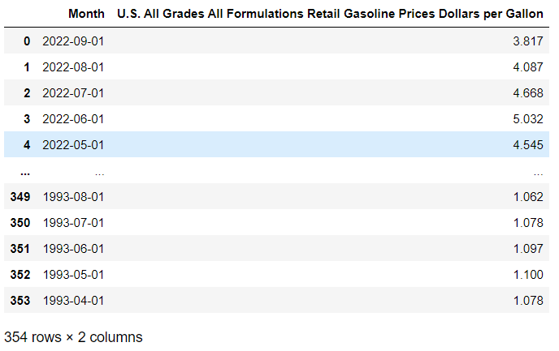
#1 : Source monthly price data
Monthly Gasoline Price Per Gallon data sourced from https://www.eia.gov/

Slide 4
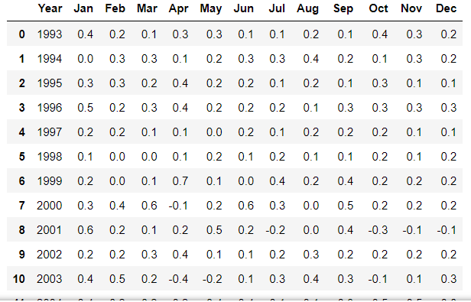
#2 : Source inflation rate data
Monthly Consumer Price Index Data sourced from https://www.bls.gov/

Slide 5
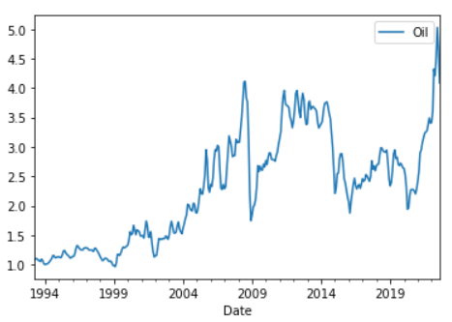
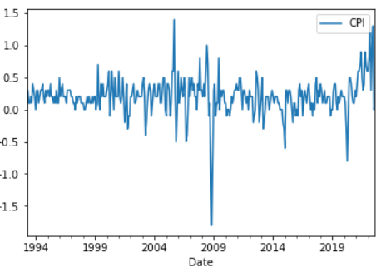
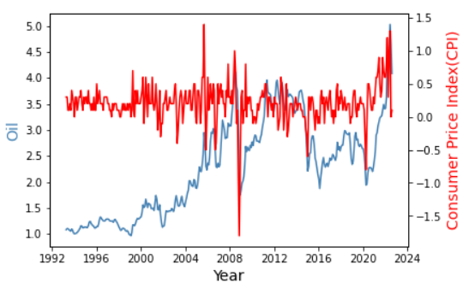
#3 :Correlation between energy costs and inflation

Slide 6
#4 : Causes for the changes
After all, not only does oil fuel the vast majority of transportation needs, it’s also a critical raw material used in consumer products far and wide, and much of the price swings in oil are passed on to consumers.
With oil moving higher compared to year-ago prices, we should naturally expect a transitory boost to headline CPI as a result.
General trend of increasing oil prices are based on global economy strength, consumptions and production of the products
We see a pattern from 2009, 2015 and 2021 – when CPI goes down oil prices also goes down. This is the time of stressful housing market, equity market crash and Covid-19 triggered pandemic
Based on last 30 years of data when CPI goes up oil prices also goes up or vice-versa.
Up trend and down trend shows a correlations between CPI and Oil prices

